Slide 1

Oracle 12c: SQL
Chapter 1
Overview of Database Concepts
©2016. Cengage Learning. All rights reserved.

Slide 2
Objectives
Define database terms
Identify the purpose of a database management system (DBMS)
Explain database design using entity-relationship models and normalization
Explain the purpose of a Structured Query Language (SQL)
Understand how this textbook’s topics are sequenced and how the two sample databases are used
©2016. Cengage Learning. All rights reserved.

Slide 3
Database Terminology
Database – logical structure to store data
Database management system (DBMS) – software used to create and interact with the database
©2016. Cengage Learning. All rights reserved.

Slide 4
Database Components
Character
Field
Record
File
©2016. Cengage Learning. All rights reserved.

Slide 5
Database Components - Character
Basic unit of data
Can be a letter, number, or special symbol
©2016. Cengage Learning. All rights reserved.

Slide 6
Database Components - Field
A group of related characters
Represents an attribute or characteristic of an entity
Corresponds to a column in the physical database
©2016. Cengage Learning. All rights reserved.

Slide 7
Database Components - Record
A collection of fields for one specific entity
Corresponds to a row in the physical database
©2016. Cengage Learning. All rights reserved.

Slide 8
Database Components - File
A group of records about the same type of entity
©2016. Cengage Learning. All rights reserved.

Slide 9
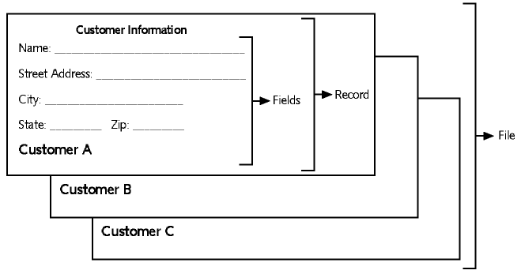
Components Example
©2016. Cengage Learning. All rights reserved.

Slide 10
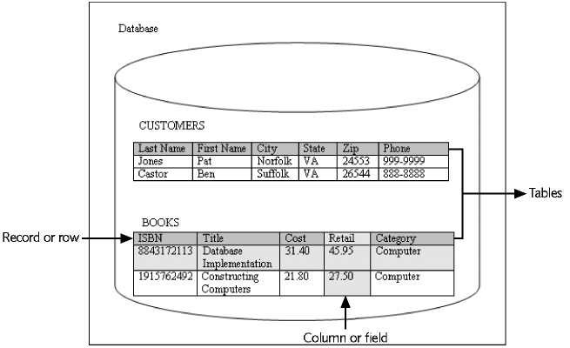
Database Example
©2016. Cengage Learning. All rights reserved.

Slide 11
Database Management System
Data storage: manage the physical structure of the database
Security: control user access and privileges
Multiuser access: manage concurrent data access
Backup: enable recovery options for database failures
Data access language: provide a language that allows database access
Data integrity: enable constraints or checks on data
Data dictionary: maintain information about database structure
©2016. Cengage Learning. All rights reserved.

Slide 12
Database Design
Systems Development Life Cycle (SDLC)
Entity-relationship model (E-R model)
Normalization
©2016. Cengage Learning. All rights reserved.

Slide 13
Systems Development Life Cycle (SDLC)
Systems investigation – understanding the problem
Systems analysis – understanding the solution
Systems design – creating the logical and physical components
Systems implementation – placing completed system into operation
Systems maintenance and review – evaluating the implemented system
©2016. Cengage Learning. All rights reserved.

Slide 14
Entity-Relationship Model
(E-R Model)
Used to depict the relationship that exists among entities
Composed of
  Squares representing entities
  Lines representing relationships

Slide 15
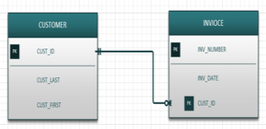
E-R Model Example
(Crow’s Feet Notation)

Slide 16
Entity-Relationship Model: Entities
Entity
  Object about which you want to store data
  Different tables store data about each different entity

Slide 17
Entity-Relationship Model: Relationships
Relationships
  Links that show how different records are related
The following relationships can be included in an E-R model:
  One-to-one (1:1)
  One-to-many (1:M)
  Many-to-many (M:N)

Slide 18
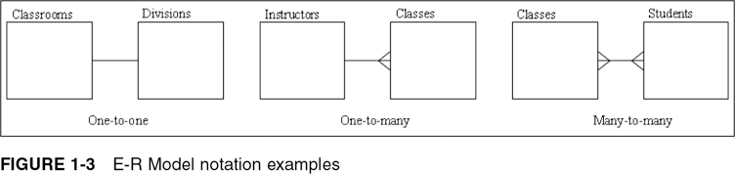
E-R Model Notation Examples
©2016. Cengage Learning. All rights reserved.

Slide 19
One-to-One Relationship
Each occurrence of data in one entity is represented by only one occurrence of data in the other entity
Example: Each individual has just one Social Security number (SSN) and each SSN is assigned to just one person
©2016. Cengage Learning. All rights reserved.

Slide 20
One-to-Many Relationship
Each occurrence of data in one entity can be represented by many occurrences of the data in the other entity
Example: A class has only one instructor, but each instructor can teach many classes
©2016. Cengage Learning. All rights reserved.

Slide 21
Many-to-Many Relationship
Data can have multiple occurrences in both entities
Example: A student can take many classes, and each class is composed of many students
Can not be included in the physical database
©2016. Cengage Learning. All rights reserved.

Slide 22
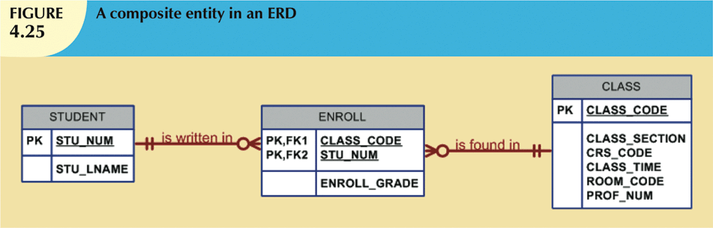
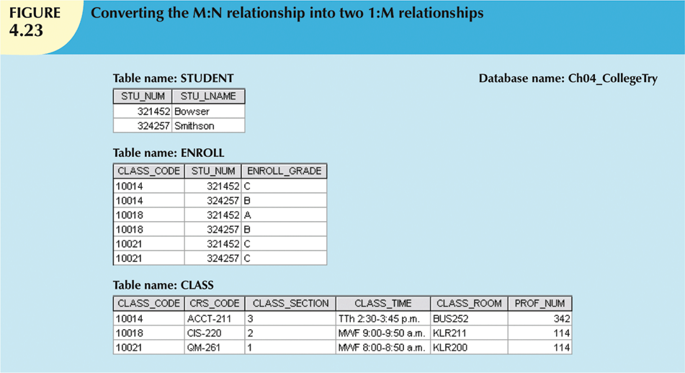
Resolving M:N Relationship Using Bridge*
*from Database Systems by Coronel

Slide 23
Business Rules
Represent detailed description of policies, procedures, or principles within a specific organization
Describe characteristics of data as viewed by the company
Allow the designer to understand business processes and the nature, role, and scope of the data
Help the designer to develop appropriate entities, relationship participation rules and constraints
Example 1:
A customer may generate many invoices.
An invoice is generated by only one customer.

Slide 24
Translating Business Rules into Data Model Components
Generally, nouns will translate into entities and verbs will translate into relationships among the entities
Example 1 (cont.):
  Entities: CUSTOMER, INVOICE
  Relationship: “generate”
Relationships are bidirectional. To identify the relationship type between two entities (A and B), always check it in both directions:
  How many instances of B are related to one instance of A?
  How many instances of A are related to one instance of B?
Example 1 (cont.): since each customer may generate many invoices (M) but each invoice belongs to only one customer (1), the relationship type between CUSTOMER and INVOICE is 1:M

Slide 25
Keys
Key fields
  Establish relationships among records in different tables
  Main types of key fields
    Primary
    Candidate
    Surrogate
    Foreign
    Composite
Oracle 11g: SQL

Slide 26
Primary Keys
Column in relational database table whose value must be unique for each row
Serves to identify individual occurrence of entity
Every row must have a primary key
Cannot be NULL
NULL
  Value is absent or unknown
  No entry is made for that data element
Oracle 11g: SQL

Slide 27
Candidate Keys
Any column that could be used as the primary key
Should be a column that is unique for each record and does not change
Oracle 11g: SQL

Slide 28
Surrogate Keys
Column created to be record’s primary key identifier
Has no real relationship to row to which it is assigned other than to identify it uniquely
Surrogate key values automatically generated using a sequence
Oracle 11g: SQL

Slide 29
Foreign Keys
Column in table that is a primary key in another table
Creates relationship between two tables
Value must exist in table where it is the primary key
Oracle 11g: SQL

Slide 30
Composite Keys
Unique key that is created by combining two or more columns
Usually comprises fields that are primary keys in other tables
Oracle 11g: SQL

Slide 31
Database Normalization
Determines required tables and columns for each table
Multistep process
Used to reduce or control data redundancy
©2016. Cengage Learning. All rights reserved.

Slide 32
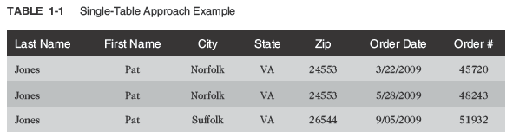
Database Normalization (continued)
Data redundancy – refers to having the same data in different places within a database
Data anomalies – refers to data inconsistencies
©2016. Cengage Learning. All rights reserved.

Slide 33
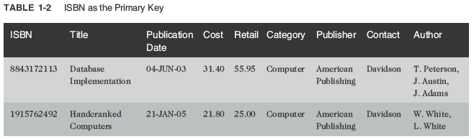
Unnormalized Data
Contains repeating groups in the Author column in the BOOKS table
©2016. Cengage Learning. All rights reserved.

Slide 34
First-Normal Form (1NF)
Primary key is identified
Repeating groups are eliminated
©2016. Cengage Learning. All rights reserved.

Slide 35
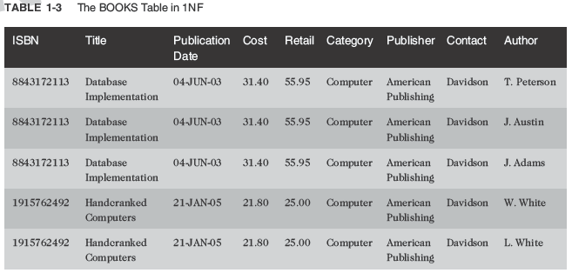
First-Normal Form (1NF) (continued)
ISBN and Author columns together create a composite primary key
©2016. Cengage Learning. All rights reserved.

Slide 36
Composite Primary Key
More than one column is required to uniquely identify a row
Can lead to partial dependency – a column is only dependent on a portion of the primary key
©2016. Cengage Learning. All rights reserved.

Slide 37
Second-Normal Form (2NF)
Partial dependency must be eliminated
  Break the composite primary key into two parts, each part representing a separate table
©2016. Cengage Learning. All rights reserved.

Slide 38
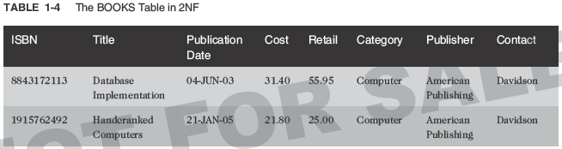
Second-Normal Form (2NF) (continued)
BOOKS table in 2NF
©2016. Cengage Learning. All rights reserved.

Slide 39
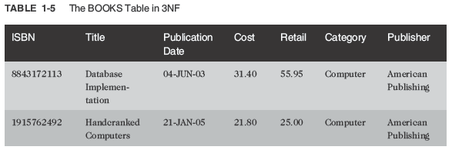
Third-Normal Form (3NF)
Publisher contact name has been removed
©2016. Cengage Learning. All rights reserved.

Slide 40
Summary of Normalization Steps
1NF: eliminate repeating groups, identify the primary key
2NF: table is in 1NF, and partial dependencies are eliminated
3NF: table is in 2NF, and transitive dependencies are eliminated
©2016. Cengage Learning. All rights reserved.

Slide 41
Relating Tables within the Database
Once tables are normalized, make certain tables are linked
Tables are linked through a common field
A common field is usually a primary key in one table and a foreign key in the other table
©2016. Cengage Learning. All rights reserved.

Slide 42
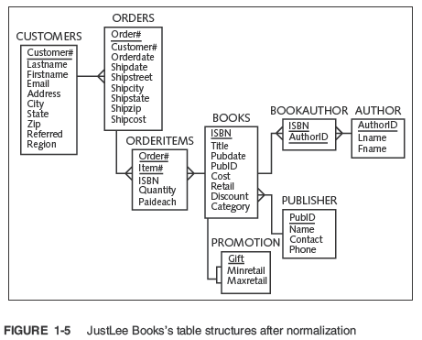
©2016. Cengage Learning. All rights reserved.

Slide 43
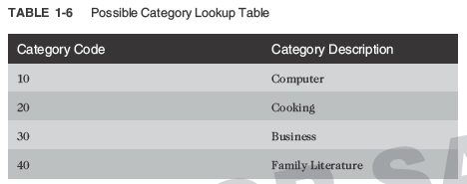
Lookup Table
Common reference for descriptive data tables referenced in a foreign key
©2016. Cengage Learning. All rights reserved.

Slide 44
Structured Query Language (SQL)
Data sublanguage
Used to:
  Create or modify tables
  Add data to tables
  Edit data in tables
  Retrieve data from tables
ANSI and ISO standards
©2016. Cengage Learning. All rights reserved.

Slide 45
Databases Used in this Textbook – JustLee Books Database
Assumptions
  No back orders or partial shipments
  Only U.S. addresses
  Completed orders are transferred to the annual SALES table at the end of each month to enable faster processing on the ORDERS table
©2016. Cengage Learning. All rights reserved.

Slide 46
Topic Sequence
The first half of the text will focus on creating a database
The second half of the text will focus on querying or retrieving data from a database
©2016. Cengage Learning. All rights reserved.

Slide 47
Summary
A DBMS is used to create and maintain a database
A database is composed of a group of interrelated tables
A file is a group of related records; a file is also called a table in the physical database
A record is a group of related fields regarding one specific entity; a record is also called a row
A record is considered unnormalized if it contains repeating groups
©2016. Cengage Learning. All rights reserved.

Slide 48
Summary (continued)
A record is in first-normal form (1NF) if no repeating groups exist and it has a primary key
Second-normal form (2NF) is achieved if the record is in 1NF and has no partial dependencies
After a record is in 2NF and all transitive dependencies have been removed, then it is in third-normal form (3NF), which is generally sufficient for most databases
A primary key is used to uniquely identify each record
©2016. Cengage Learning. All rights reserved.

Slide 49
Summary (continued)
A common field is used to join data contained in different tables
A foreign key is a common field that exists between two tables but is also a primary key in one of the tables
A lookup table is a common term for a table referenced in a foreign key
A Structured Query Language (SQL) is a data sublanguage that navigates the data stored within a database’s tables
©2016. Cengage Learning. All rights reserved.

